Slide 2
Joint Action on Health Workforce Planning and Forecasting
STATUS BRIEFING
Michel Van Hoegaerden
Programme Manager
EU Expert Group
16/11/10, Brussels

Slide 3
WHAT IS NEW SINCE LAST MEETING ?
Web Site
Registrated handbook
Kick-off in Romania of the Joint Feasibility Study RO/MO
Save the date of the Closing event (=3rd Plenary Assembly & Stakeholder Forum)

Slide 4

1. New Web Site
New domain name with a future:
www.healthworkforce.eu

Slide 5

2. Registrated Handbook
You are encouraged to:
Use it
Copy it
Quote it
Proposal upgrades
…
The handbook is yours !
The translation in Italian is foreseen and in Partnership with WHO other languages might be developed

Slide 6


3. Kick-off in Romania of the Joint Feasibility Study Romania / Moldova
First Meeting October 5th, 2015
In the continuation of the Romanian National Dialogue on HRH
University Babes-Bolyai of Cluj is in charge of providing interviews and analysis by next meeting

Slide 7

4. Save the date of the Closing event (=3rd Plenary Assembly & Stakeholder Forum)
See invitation in your leaflet of documents
Place / Belgium May 3rd & 4th, 2016
2 days meeting, jointly policy dialogues, plenary assembly & stakeholder forum

Slide 8
PROGRESS SINCE LAST MEETING
Deliverables
Pilot Projects
Conference

Slide 9
1. Status of deliverables
Horizontal work packages
WP 1
Coordination
Belgium
WP 2
Dissemination
Slovakia
& EHMA
WP 3
Evaluation
Finland
& Malta
Final version of the Stakeholder analysis to be presented at the next E.B.

Slide 10
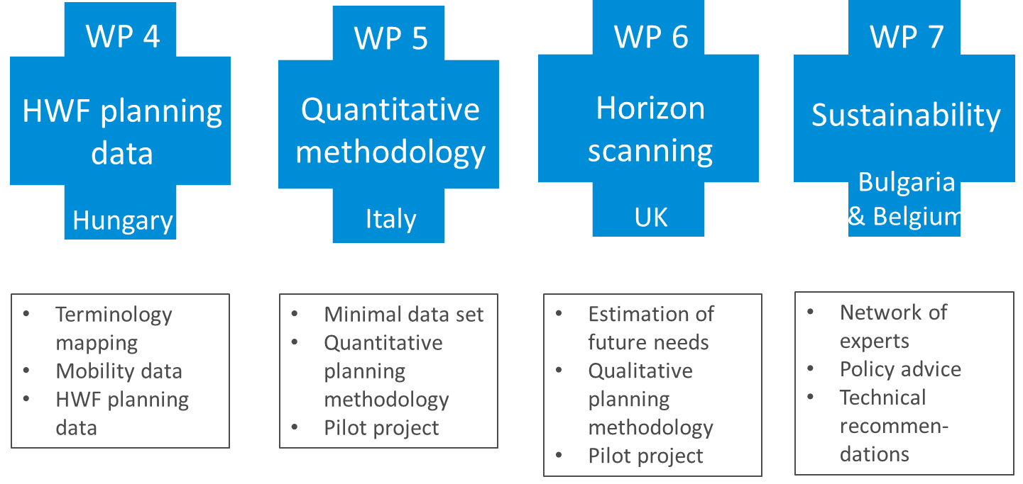




Core work packages

Slide 11




Core work packages:
Data
D041 - Terminology mapping: Creating better understanding of terminology for intl. data
D043 – HWF planning data: Providing information on data gaps and challenges in data collection for HWF planning
+ WP4 Toolkit and Recommendations
for delivering better quality HWF Planning data
D042 - Mobility research: Providing updated information on mobility trends of HWF
+ WP4 report on the applicability of the WHO CODE of Practice
To be presented at the next E.B.
Notes:
Tools on D043
Exemple of question:
Have you set-up a tangible/reachable definitive goal for HWF Planning?
→ (go to D052)
Do you have a clearly communicated and accepted HWF Planning structure, information and data flow at national level?
→ go to Tool 3
Are the results of HWF Planning channelled into policy implementation?
→ go to Tool 7
Have you confirmed clear roles of actors in HWF Planning?
→ go to HWF Planning Pathway Model and consider the steps

Slide 12


Core work packages:
Planning Methodology
See Section on Pilot Projects
D051 - Minimum dataset: Agreeing on minimum data requirements for HWF planning
D054 - Experiences of pilot projects:
Sharing results of testing the handbook and guidelines
D052 and D053 - (web-based) Handbook on planning methodologies:
Reviewing and assessing 7 advanced health workforce planning methodologies and selecting good useful practices for other Member States to learn from
Notes:
Quickly

Slide 13

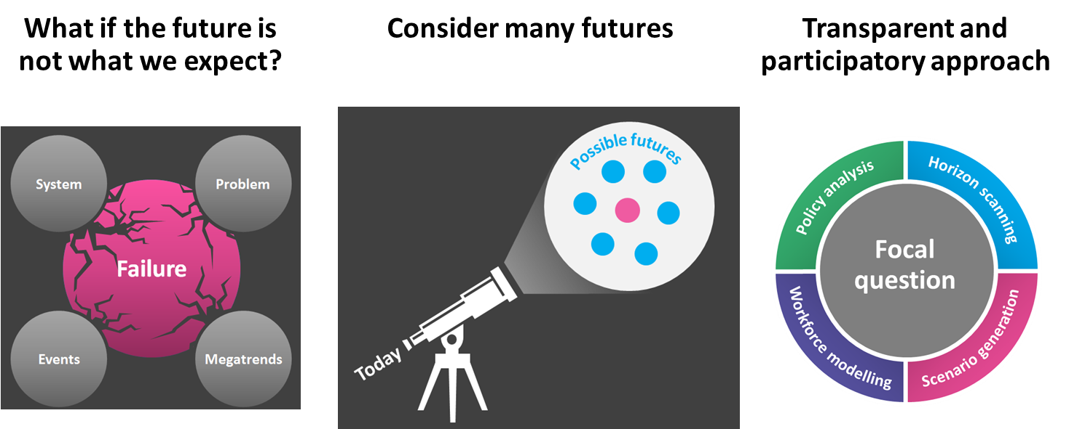
Core work packages:
Horizon scanning
D061 - User Guidelines on estimating future needs: Identification and classification of the various methodologies used to do qualitative health workforce planning across Member States
D062 - Policy reports on future competences (skills, knowledge, attitude): Estimation of future competences needed in the health workforce in 2035
D064 - Report on pilot project in Belgium: Test the methods in the user guidelines together with the policy reports in Belgium on physicians
To be presented at the next E.B.

Slide 14




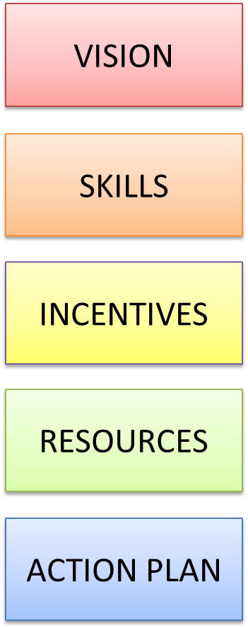


D071 - Sustainability strategy: How to increase impact of results of Joint Action on HWF-policy in Europe
D072 – List of Experts: Identifying experts (individuals & organisations) to take work forward for sustainable impact
D073 – Technical recommendations: Analyses deliverables of Joint Action and targets key technical messages and recommendations to the right audiences
D074 – Policy recommendations: Analyses deliverables of Joint Action and targets key policy messages and recommendations to the right audiences
Insufficient progress – extra meeting foreseen (see agenda)

Slide 15





2. Status of Pilot Projects & Feasibility Studies
03/15
20/21 Italian regions participating & building up a national consensus on the calculation of Stock and Needs
Country wide implementation of systematic data collection and planning for the 4 professions in scope, starting with nurses and physicians
Feasibility study of applying planning methodologies, together with states of Bremen, Hamburg & Lower Saxony.
Joint Feasibility Study on bilateral planning with Romania & Moldova, taking place within the Romanian national dialogue on HWF
Horizon Scanning and data qualification exercise on Belgian General Practitioners
03/15
01/15
03/15
D061 - User Guidelines on estimating future needs
01/15
Notes:
You can download on our website

Slide 16
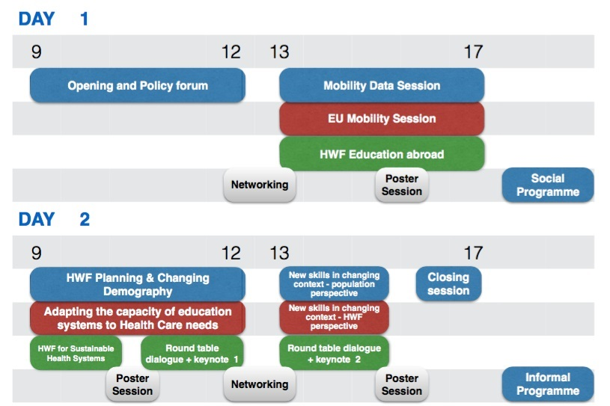
3. Joint Action Conference n°3
18 & 19 februrari 2016 – VARNA (BG)
Notes:
For conference, ask for proposal of speaker

Slide 17

UPCOMING AGENDA
 |  | 18-19 Feb 2016 | Joint Action Conference n°3 Varna (BG)
 |  | 10 March (tbc) 2016 | Additional WP7 Workshop on sustainability options Brussels (BE)
 |  | 3-4 May 2016 | Closure Event & Plenary Assembly meeting n°3 Belgium (exact place & date TBD)
Notes:
For conference, ask for proposal of speaker

Slide 18


Thank you for your attention!
Website
http://www.healthworkforce.eu
Email
EUHWForce@health.belgium.be

