Slide 1
Horizon Scanning: future skills and competences of the health workforce in Europe
MATT EDWARDS and JOHN FELLOWS
WP6, EU JA on Health Workforce Planning and Forecasting
Centre for Workforce Intelligence (CfWI), UK
_____________________________
EU Expert Group
Brussels, November 2015

Slide 2
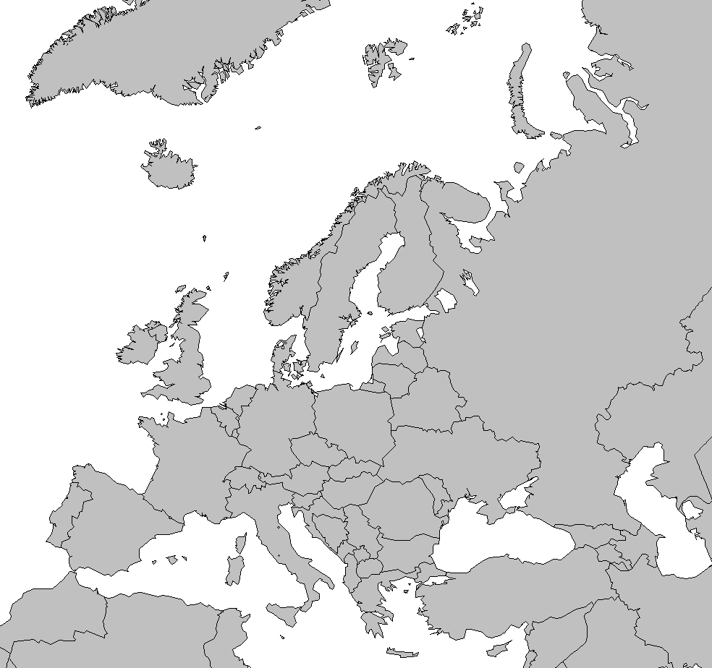
WP6 Horizon Scanning
Qualitative
methods
Published Nov 2014
Horizon scanning
and qualitative
Future skills
Forthcoming
Pilot
study

Slide 3
Objective of report on future skills and competences
“The report will give an estimation of the future needs of skills and competences and their distribution. It will contain a series of papers either covering off a key professional group (e.g. nurses) or a large trend (e.g. ageing population).”

Slide 4
Horizon scanning
Horizon scanning in health workforce planning and forecasting is used to explore and describe the factors and forces, and their inter-relationships, in workforce systems.
The use of horizon scanning and the produced report and briefs aim to increase our collective knowledge of the factors and forces which may drive changes in the skills and competences required from health workforces over the next 20 years.
Context
Ideas bank
System mapping
Issues
Probability
Impact
Workforce
Stakeholder
Factors
Events

Slide 5
Skills and competences
The language of skills and competences is useful when considering multiple health workforces, and their potential activity in the future, because it allows a consideration of what will need to be done rather than trying to work forward from the existing division of roles and responsibilities.
To develop this approach, skills and competences are conceptualised in a generic framework (consistent with approaches in, for example, Cowan et al, 2005 and UEMS, 2011) where competences are a complex (and interacting) combination of skills, knowledge and personal attributes.
Skills and competences framework (CfWI, 2014)

Slide 6
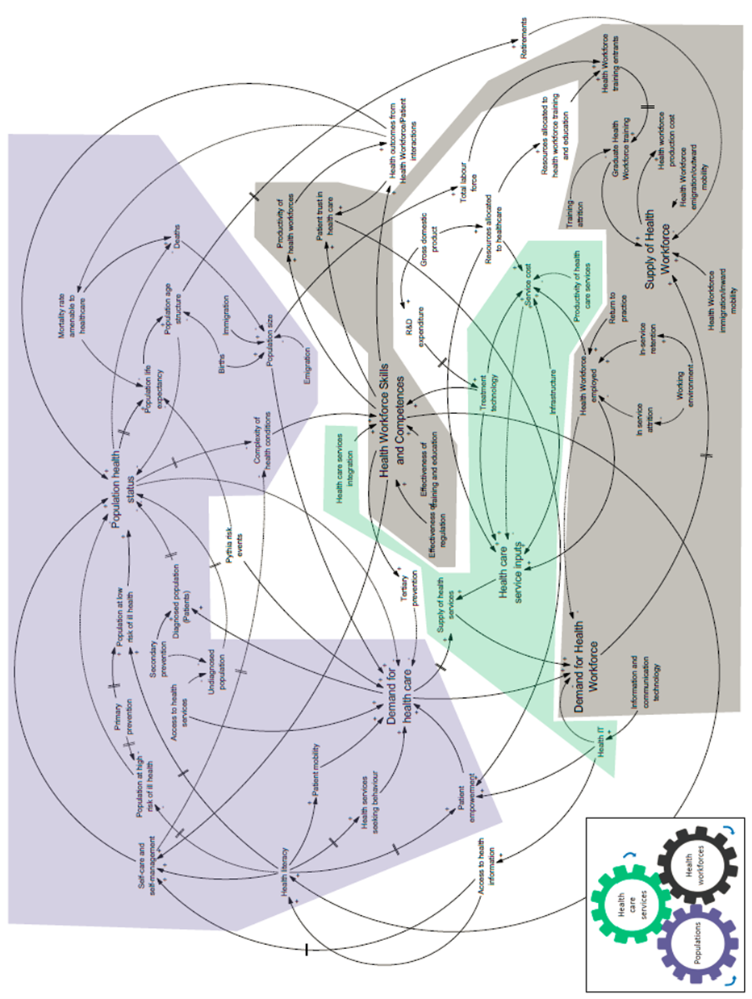
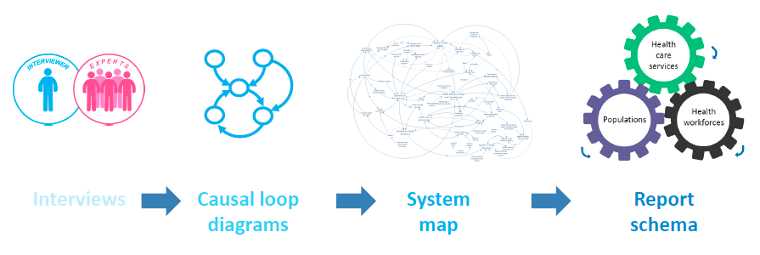
Methodology
Horizon scanning has been conducted by a network consisting of WP6 partners led by the CfWI, in collaboration with the UK Department of Health.
Focal question: ‘Thinking up to the year 2035, what are the key driving forces that will influence the skills and competences required in the health workforce?’
56 interviews, 264 drivers, over 6000 data items coded, visualised and processed as part of the work.

Slide 7
Future skills and competences - report and briefs

Slide 8
High-level drivers of change identified out to 2035
Populations | Health care services | Health workforces
Population structure Long term care and availability of unpaid carers Types and distribution of health conditions Multimorbidity Health inequalities Health literacy Patient mobility | Health care expenditures Health IT and health services Genomics and precision medicine Location of care by setting Roles and decision rights Regulation | Ageing health workforce Multi-professional education and adaptation of competences Health IT and health workforces Skill mix Health workforce mobility
…which have implications to skills and competences

Slide 9
Populations
Skills and competence implications Prevention – ‘the ability to reduce the instance or incidence of ill health and social health’ (CfWI, 2014). Coaching and health promotion – ‘engaging and empowering individuals and communities to engage in healthy behaviours, and make changes that reduce the risk of developing chronic diseases and other morbidities’ (WHO, 2015). Multi-disciplinary team working that includes a range of ‘different professional groups, deliver[ing] higher quality patient care and implement[ing] more innovations in patient care’ (Borrill et al, 2013).
Continued in horizon scanning brief which includes examples of workforce impacts, education and training, workforce planning considerations.

Slide 10
Health care services
Skills and competence implications Information interpretation skills resulting from developments in eHealth may increasingly have wide ranging impacts on patients, the workforce and health systems (EFN, 2014). An awareness of, and detailed genetic assessment and treatment skills, will be an important for the workforces involved in assessment, diagnosis and treatment. The scope of workforces may also expand to new genetic advisory and therapy health professionals as part of multi-disciplinary teams.
Continued in horizon scanning brief which includes examples of workforce impacts, education and training, workforce planning considerations.

Slide 11
Health care workforce
Skills and competence implications Resilience – The health workforce faces many changes ahead driving increases in resilience and coping skills. Changes in health systems, populations, patient expectations, technologies and innovations over the next 20 years will drive increases Regulatory awareness and revalidation skills – Health care professionals working in the EU face differing regulatory and re-certification changes as revalidation becomes more prevalent in Europe’s health systems Systems thinking and workforce planning skills and competence will be areas of increased demand for the future. The interconnectedness of how health systems operate, their complexity and how they interact have implications for the achievement of equitable health outcomes (Adam, 2012).
Continued in horizon scanning brief which includes examples of workforce impacts, education and training, workforce planning considerations.

Slide 12
Summary of messages
The work shares the methods used to conduct horizon scanning and provides tools – such as a system map to understand the dynamic nature of future change – which can be adapted to conduct and improve workforce planning in national-specific contexts.
The report describes the variables and the relationships involved in workforce systems, highlighting the drivers of change to populations, health care services and health workforces. This qualitative understanding is best combined with quantitative modelling in national-specific contexts to project the relative size and uncertainty of workforce supply and demand pressures.
The future of workforce planning must include multi-professional projections which effectively inform decision making by linking to appropriate policy decisions and combining qualitative and quantitative approaches.
Available at www.healthworkforce.eu in 2016

Slide 13
Acknowledgements
Thank you for the continued support from the EU Commission, EU Joint Action team, the Department of Health, UK and our national and international partners and advisors for participating in this and connected research.
Questions welcomed.

