Slide 1
Implementing the WHO Global Code: the Irish Experience
Prof. Ruairí Brugha, Department of Epidemiology and Public Health Medicine, Royal College of Surgeons in Ireland (RCSI)
Lisbon, Portugal, 16th June 2014

Slide 2
1. About the WHO Global Code
Developed by a partnership of the Global Policy Advisory Council and WHO, 2007-2010
Adopted by World Health Assembly (WHA 63) in 2010
Voluntary principles + practices to be implemented by member states for ethical recruitment and strengthening of health systems
Main recommendations:
Ethical international recruitment
Health workforce development and health system sustainability
Train and Retain
Fair treatment of migrant health personnel
International cooperation
Support to developing countries
Data gathering, reporting and research

Slide 3
2. Ireland’s HRH Challenges: 2000-2013
Between 2000 and 2008, the percentage of foreign trained doctors increased from 12% to 35% - 25% of these doctors coming from ‘high-burden’ countries
Between 2000 and 2006, more than 50% of all nurses registering in Ireland were non-Irish
Ireland biggest recruiter of foreign trained nurses and second biggest for doctors (in % terms) among OECD countries (2008)
Due to economic crisis, there has been a reduction in health workforce of 12,505 WTEs (-11%) since September 2007
Ireland now produces sufficient graduates in medicine and nursing, but is experiencing recruitment and retention challenges across the public healthcare system

Slide 4
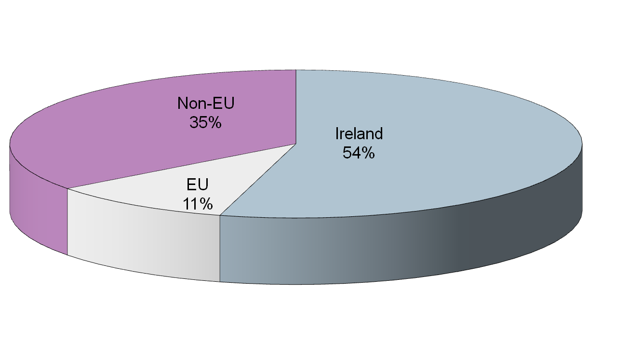
Nurses newly registered with Irish Nursing Board 2000-2010
N=31,810
Source: An Bord Altranais, 2010

Slide 5
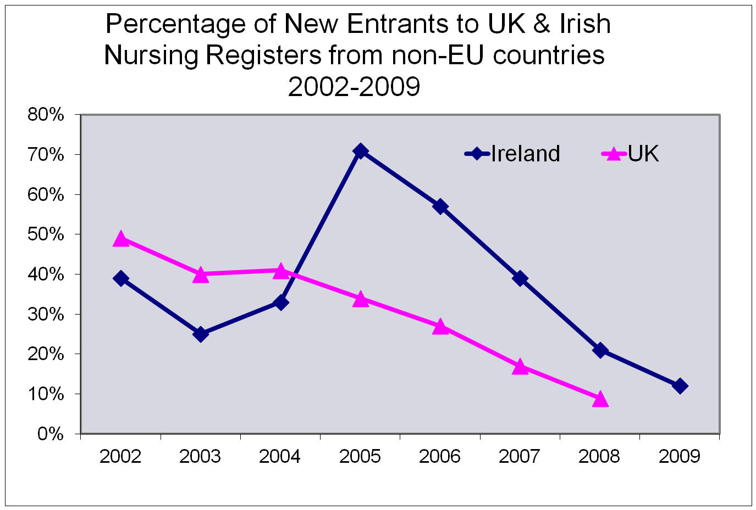
Sources: Irish Nursing Board 2010; Nursing and Midwifery Council, 2008

Slide 6
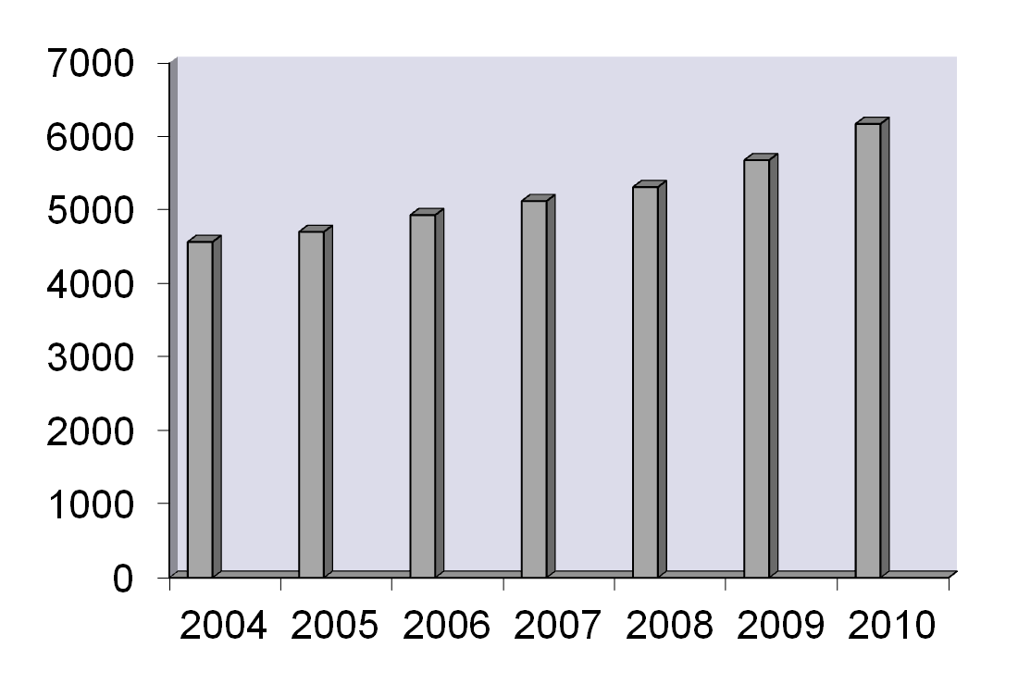
Irish Registered Nurses ‘working abroad’ 2004-2010

Slide 7
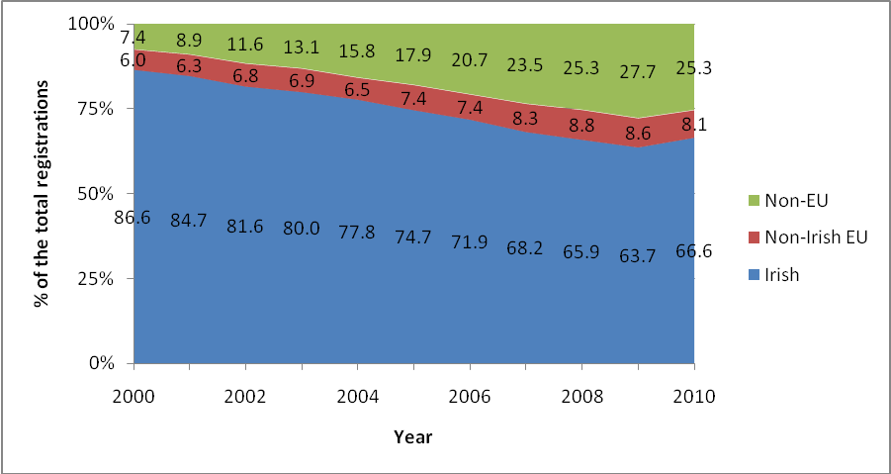
Country of qualification all registered doctors: 2000-2010
Medical Council registrants by country of qualification (2000-2010)

Slide 8
Country of qualification for non-EU graduates: 2000 + 2010
% indicates the proportion of total non-EU registrations

Slide 9
Country of qualification for EU graduates (excl Ireland): 2000 + 2010
% indicates the proportion of total EU registrations

Slide 10
3. Ireland and the WHO Global Code
Committed to principles of Global Code including health worker self-sufficiency and ethical international recruitment
Collaborative implementation: Ireland’s Dept of Health, Dept of Foreign Affairs (Irish Aid) and Health Service Executive (HSE)
MoU between the Health Service Executive and Irish Aid to enhance collaboration on global health issues including HRH (2010)
Establishment and roll-out of the International Medical Graduate Training Initiative (2011-2013)
Agreed commitments for 3rd Global Forum on HRH, Recife (2013)
Currently developing long-term strategic health workforce planning framework and approach (2014-2015)
Ireland’s work on Code implementation recognised in 2013 Health Worker Migration Policy Council Innovation Award
Strong links between policy, planning and research – next ..

Slide 11
4. Research: Doctor Migration (IMG) 2010-14
Mixed method study of inward migration of non-EU migrant doctors (IMGs) to Ireland:
Qualitative interviews (N=37)
Quantitative survey (N=337)
IMG respondents came to Ireland for career progression and to obtain further training/qualifications
Mismatch between expectations of IMGs and the reality:
most ended in service posts providing limited / no training
therefore limited career progression.
Publications:
A cycle of brain gain, waste and drain – a qualitative study of non-EU migrant doctors in Ireland. Humphries et al. ….. Human Resources for Health 2013: 11:63
‘I am kind of in stalemate’. The experiences of non-EU migrant doctors in Ireland Humphries et al. Ch 10, Health Professional Mobility in a changing Europe. 2014

Slide 12
4. Research findings (hot off the press!) point to: Onward – not Return - Migration
Country of | Total number (N) | Staying in Ireland (n) | Returning home (n) | Migrating elsewhere (n)
Training
Pakistan | 81 | 31 | 9 | 41
Ireland | 57 | 10 | 0 | 47
South Africa | 41 | 7 | 13 | 21
Nigeria | 38 | 17 | 4 | 17
Sudan | 28 | 4 | 5 | 19
Other | 57 | 20 | 13 | 24
TOTAL | 343 | 104 | 57 | 182
Percent |  | 30.3% | 16.6% | 53.1%

Slide 13
5. International Medical Graduate Training Initiative (2011 – present)
Underpinned by Global Code and principle of reciprocity
Enables suitably qualified overseas postgraduate medical trainees to undertake fixed period of clinical training in Ireland
Structured training program developed by Irish postgraduate medical training body to meet the clinical needs of participants as defined by their home country’s health service
Established in 2011 – first bi-lateral agreement signed with College of Physicians and Surgeons of Pakistan (CPSP)
Launched in 2013 – joint pilot with the CPSP
Continued roll-out in 2014 – c. CPSP 100 trainees offered posts under the Initiative following joint selection process

Slide 14
6. Features of the IMGTI
Aimed primarily at doctors (International Medical Graduates – IMGs) from countries with less developed health sectors
Period of clinical training is ordinarily 24 months
After the 24 month period elapses, participants return to their country of origin
Training provided in clinical departments approved for post-graduate specialist training in Ireland provided that training position is incorporated into an IMG training programme :
that is tailored to the educational/training objectives of the participant
that takes into account the needs of the health service in the doctor’s home country

Slide 15
7. IMGTI Governance
International Medical Graduate Training Initiative (IMGTI) overseen by Ireland’s Health Service Executive (HSE) and the Forum of Irish Postgraduate Medical Training Bodies
National level committee comprising representatives of both bodies
National IMGTI framework developed and adopted in January 2014
Responsibility for policy roll-out and implementation – HSE Medical Education and Training Unit
Close cooperation with relevant Government Departments in relation to appropriate visa and work permit arrangements

Slide 16
8. Developing the IMGTI – Next Steps
Discussions ongoing with other interested countries
Enhancing alignment of medical training with needs of home country health services
Encouraging applications for different levels of training relevant to home country health service needs e.g. in sub-specialties such as oncology
Review of the first phase of roll-out of the Initiative with the first cohort of CPSP trainees in 2015

Slide 17
9. Finally: Addressing Health Workforce Weaknesses in the Irish Health System
Research: Doctor Emigration Project, 2014-16
Collaboration between RCSI researchers, Medical Council of Ireland and HSE-MET
Circa 600 Irish doctors responded in May June 2014 to questions on emigration nested in Medical Council Trainee survey
Findings even hotter off the press!
One quarter of Irish trainee doctors will probably / definitely emigrate
One quarter undecided
Half will probably / definitely stay
Qualitative study and cohort (follow-up) tracking study planned (2015-16)

