Slide 1
DG MARKT
Regulated Professions Database
_____________________________
WP4 Roma Workshop
3 December 2014

Slide 2
Regulation background
The Regulated Professions Database is set up and maintained on the basis of Directive 2005/36/EC on the recognition of professional qualifications
Each country provides data about their regulated professions, the recognition processes of qualifications and the number of recognition decisions by profession.

Slide 3
Types of recognition processes
Establishment
The automatic recognition of professional qualifications is in place for seven professions known as "sectoral" professions:
Architects, Dentists, Doctors, Midwives, Nurses, Pharmacists, Veterinary surgeons
The general system
Recognition of professional experience
Temporary provision of services (no recognition but declaration)
The definitions can be found on the website.

Slide 4
Objective
Fulfillment of the obligations under the Directive (Art. 60)
The objective of the database is to gather information on regulated professions (currently upgraded on the basis of Directive 2013/55/EU) and
to provide statistics on the recognition of professional qualifications in line with the Directive

Slide 5
Data for mobility research?
These are not mobility data! Data about recognition decisions of professional qualifications!
Data only about the recognition within the European Union, EEA countries and Switzerland
The professionals who obtained qualifications in a third country are not covered by this database (nor by the Directive 2005/36/EC)
No personal data provided!

Slide 6
Data collection process
Information is uploaded into the database by the national authorities, which are designated by each country
Depending on the internal organisation in each country, competent authorities for each profession submit information (e.g. health professions), to the national coordinator or directly into the database.
The data is finally validated by the Commission

Slide 7
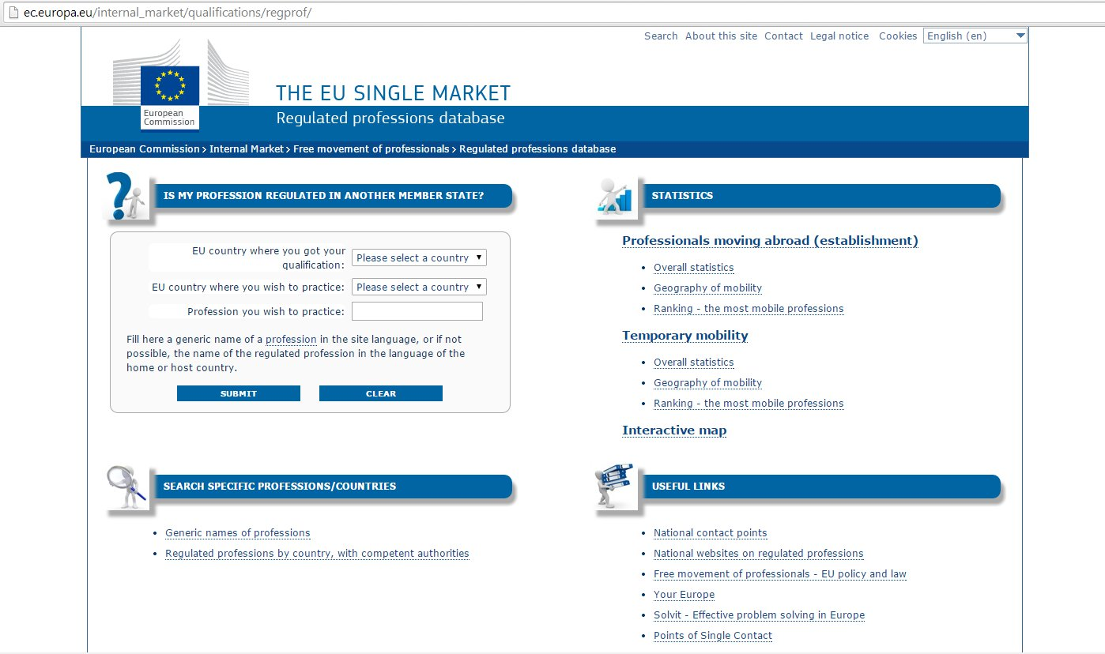
Use of the data
The statistics of provided data are available on the website: http://ec.europa.eu/internal_market/qualifications/regprof/
Basic statistics, special options for searches, Excel or PDF reports can be generated

Slide 8
Thank you for your kind attention!
Questions?

