Slide 1
Data and definitions in The Health PROfessional Mobility in THe European Union Study (PROMeTHEUS)
Irene A. Glinos
European Observatory on Health Systems and Policies
JA HWF, wp4 workshop, Rome 3rd Dec 2014

Slide 2
Outline
Prometheus project
Working definition
Measuring HP mobility:
Indicators
Comparisons inflows >< outflows
Not measuring mobility:
Who are the mobile individuals?
Typology

Slide 3
Project objectives
Address knowledge gaps:
Magnitude
Enlargement
Motivations
Impacts
Relevance
Policy options
(2009-2013)
The research leading to these results has received funding from the European Community's Seventh Framework Programme (FP7/2007-2013) under grant agreement n°223383.

Slide 4
Volume I: 17 countries
EU-15: Austria, Belgium, Finland, France, Germany, Italy, Spain, UK
EU-12: Estonia, Hungary, Lithuania,
Poland, Romania, Slovakia, Slovenia
Non-EU: Serbia, Turkey
2011
FI
EST
LIT
UK
PL
BE
DE
SK
AT
FR
HU
RO
SL
Serb
IT
Turkey
ES
Notes:
4
Collected quantitative + qualitative data in 17 c.
In 8 eu-15 c.
In 7 eu-12 c.
In 2 c. having applied for eu membership
Also collected quantitative data for some other imp. destination c. such as Switzerland, Norway, Auz, NZ
Last but not least were in contact with researchers in Moldova and Ukraine... Not poss due to other commitments of the research teams

Slide 5
Volume II (2014): thematic
The changing dynamics of health professional mobility: data, definition/ typology, EU enlargement, financial crisis
The mobile individual (Germany, Ireland, Lithuania, UK, nurses RN4Cast)
Policy responses
Domestic
Bilateral agreements
International frameworks
Managerial responses
Retention of nurses
Policy responses outside Europe

Slide 6
Defining mobility
No common definition
Working definition:
Any intentional change of country after graduation with the purpose and effect of delivering health-related services, including during training periods. (2009)

Slide 7
Indicators
Foreign-trained, foreign-born, foreign-national
(but do these always measure mobility?)
Registry, census, labour market, work permits, intention-to-leave
Registration; self-employed; private sector; public sector; active vs. total, reregistration…

Slide 8
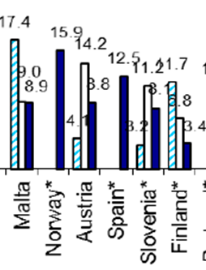
Reliance on foreign doctors – STOCK DATA 2008

Slide 9
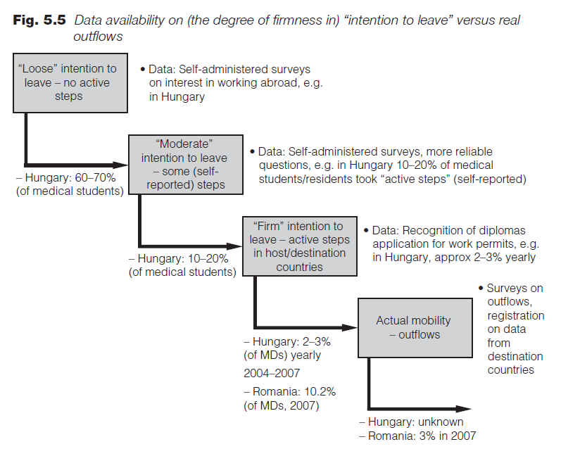
How to measure outflows
Outflows < certification requests
Lithuania:
60% MD
50% NU
70% DE
are on foreign registries

Slide 10
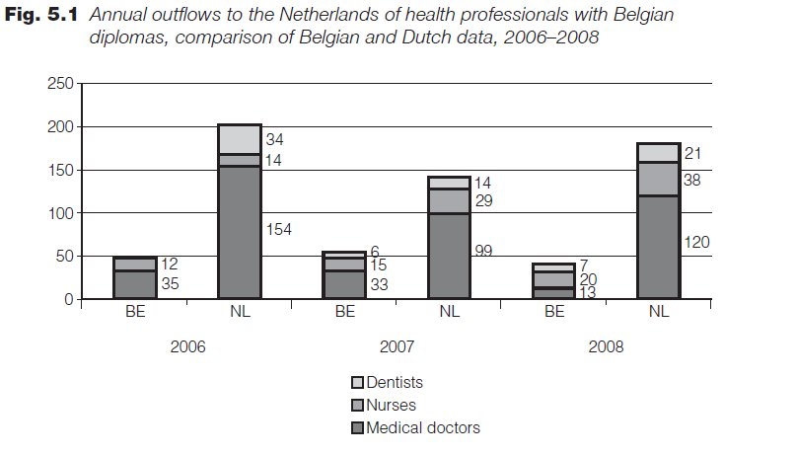
Outflows > certificate requests

Slide 11
Why go beyond numbers
Part of the story
Old story
How to keep up with developments?
the faster mobility changes, the faster we have to adapt
Simplified story
Numbers < variety of mobility
Mobility, and our understanding of it, is changing
Policy story?
Causality: changes in flows ← → HWF policies ?
Data can show what is going on, but not why
Why are people leaving? Why are they returning?
Numbers are expensive

Slide 12
Defining mobility
Working definition:
Any intentional change of country after graduation with the purpose and effect of delivering health-related services, including during training periods. (2009)
Any movement across a border by a health professional after graduation with the intention to work, that is, deliver health-related services in the destination country, including during training periods. (2013)
The individual
The diversity of movements
The possibility of non-work

Slide 13
Beyond numbers: the individual and her motivations
17 case-studies
Germany, Ireland, Lithuania, UK, nurses RN4Cast
Diversity of individual migration experiences
Typology of health professional mobility
1. The livelihood migrant
2. The career oriented
3. The backpacker
4. The commuter
5. The returner
6. The undocumented
Ongoing story
‘Once a migrant, always a migrant’

Slide 14
What does data limitations mean for: student mobility
Anecdotic evidence: young mobility does not return (?)
Do the brightest leave?
Foreign-trained and foreign-nationals
Importance of the ‘backpacker’ and the ‘career oriented’

Slide 15
What does data limitations mean for: countries with high dependence
Do they benefit from the crisis?
Mobility is a moving target: today you win, tomorrow you loose (ex. Spain) (what if other c become more attractive)
The younger are more likely to stay on?
You are not in control of inflows and data only tell the old story
System’s ability to absorb/ integrate:
Finland: unemployment
France, Ireland: working below skills level
Nurses
“Opportunities in an expanding health service” (late 2010)
Source: Buchan
& Seccombe 2012

Slide 16
What does data limitations mean for: countries facing losses
Economic crisis > Enlargement ??
Big winners >< big losers
Outflows
Health system in crisis
No capacity to collect data
The undocumented

Slide 17
Mobility is changing
Diversity of individual migration experiences
The livelihood migrant
Crisis escapee
2. The career oriented
- can host/home system absorb their skills?
3. The backpacker
- young departure, no return?
4. The commuter
- daily/ weekly/ monthly/ 1 or 2 jobs/ short-term, long-term not relevant
5. The returner
- likely to be more mature? (younger stay abroad)
6. The undocumented
Mobility not monolithic
New map of Europe?

Slide 18
Tentative recommendations
A yardstick for better data:
Coverage
High c of most common health professionals
Mandatory nationwide registration
Mobility indicators
Inflows/ stock: all three indicators (f-t, n, b)
Outflows: international exchange of mobility data
Timeliness
Compulsory registration and deregistration (short-term, returns)
Activity levels
Triangulation
International collaboration

Slide 19
To know more...
Thank you for your attention
igl@obs.euro.who.int

Slide 20
The Health PROfessional Mobility in THe European Union Study
(2009-2013)
The research leading to these results has received funding from the European Community's Seventh Framework Programme (FP7/2007-2013) under grant agreement n°223383.

Slide 21
Causality: changes in flows ← → HWF policies ?
Data may show what is going on, but not why
Why are people leaving? Why are they returning?
Where in host country do they go? Geographical
Those not using their skills, ending up in other work

Slide 22
Beyond numbers: the individual and her motivations
17 case-studies
Germany, Ireland, Lithuania, UK, nurses RN4Cast
Diversity of individual migration experiences
Typology of health professional mobility
1. The livelihood migrant
2. The career oriented
3. The backpacker
4. The commuter
5. The returner
6. The undocumented
Ongoing story
‘Once a migrant, always a migrant’
Typology of health professional mobility
1. The livelihood migrant
2. The career oriented
3. The backpacker
4. The commuter
5. The returner
6. The undocumented

