Slide 1
Work Package 4
Rome workshop
ZOLTAN ASZALOS
WP4 Leader
EDIT EKE
WP4 Scientific Leader
ZOLTAN CSERHATI, RÉKA KOVÁCS
ESZTER KOVACS, EDMOND GIRASEK, ANDRAS WEBER
WP4 Experts
Health Services Management Training Centre / Semmelweis University
_____________________________
3rd December 2014

Slide 2
WP4 Timeline
Brussels Kick-off - 12 April 2013
Budapest Workshop - 13/14 June 2013
Bratislava Workshop - 30 Jan 2014
Utrecht Workshop - 6/7 March 2014
Rome Workshop - 3 December 2014
"Defeated distance and limitless steps" - HWF mobility and HWF planning WS

Slide 3
WP4 Activities
3. HWF data gap analysis: Availability of HWF data for planning
2. Mobility data mapping + WHO Code
1. Terminology mapping: Data contents that match definitions - JQ
D041 Version 1.0. to partners in January 2015
D042 Submission to EB in March 2015
WHO: Report to partners in February 2015
Launching work in Rome
Major workshop in June 2015
EB final approval in March 2015

Slide 4
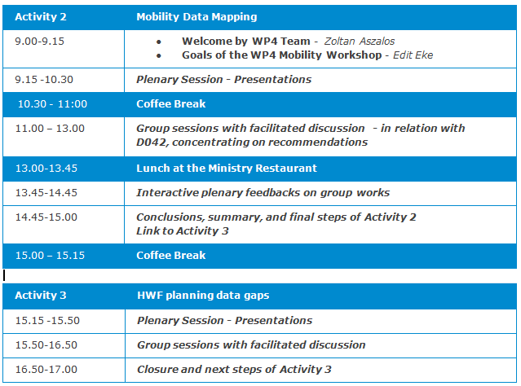
WP4 Rome workshop Agenda

