Slide 2
Mobility of Physicians
-
opportunities and threats
Ljubljana – May 9th, 2014 – ECTS-MA Network

Slide 3
GOOD MORNING
Michel Van Hoegaerden, Eng., MSc
Currently Programme Manager of the EU Joint Action on Health Workforce Planning & Forecasting, appointed by the Federal Public Service of Health (Belgium)
Former General Manager at the Federal Public Service of Health (Belgium), in charge of Primary Health Care, Emergency Care, Crisis Management & Health Professionals.

Slide 4
MOBILITY … VARIOUS CONCEPTS
Permanent mobility to EU
Permanent mobility intra EU
  To another country than nationality / training country
  Back home when trained abroad
Permanent mobility from EU
Circular mobility in the context of training
Circular mobility in the context of a career
(Semi-)permanent or Circular mobility in the context of a bi-lateral agreement
Temporary work
Cross-border work
Notes:
Key message:
Mobility is covering various concepts in many mouths, the gaps in the definition are confusing the analysts, and are sometimes used for undue demonstrations based on political ideas.
Attempts are made to close the gaps of definitions, either scientifically (I. Glinos – Prometheus II) or through regulation instruments (EC/2005/36)
All mobility's have their own motivation – there is no Black or White – Good or Bad mobility's.

Slide 5
MOBILITY – RIGHTS & FEARS
Mobility could be looked at and defined very different ways.
+
(easy) Mobility of individuals is an achievement !
Open EU Market (services, goods & workers) is a EU fundamental
Mobility is a tool to fight unbalances of HC provision to patients
Quality improvement of the training & research through foreign experience/collaboration is generally agreed
Inter-university collaboration offers scale effect oppotunities
…
Planning can become out of political control (we do not know anymore who we have in the future)
Snowball effect
Greater unbalances with impact
Countries becoming dependant on foreign workforce
Protectionist behaviours & fear of lower quality
…
-
Notes:
There are pro’s and contra’s to mobility. The question is to those who want to restrict it : Why should HW have less rights than other workers ?
The policies to put in place must be courageous to find solution for the unbalances, in a faire relation between EU States. Currently, several political debates use the fears, or prefer ignoring the impacts (positive or negative).

Slide 6
MOBILITY & GOVERNANCE
Abstract of “Health professional mobility in a changing Europe. New dynamics, mobile individuals and diverse responses”
Health professional mobility in Europe has become a fast-moving target for policy-makers. It is evolving rapidly in direction and magnitude as a consequence of fundamental change caused by European Union (EU) enlargement and the financial and economic crisis.
Health professional mobility changes the numbers of health professionals in countries and the skill-mix of the workforce, with consequences for health-system performance. Countries must factor in mobility if they are forecasting and planning their workforce requirements. To this end they need clarity on mobility trends and the mobile workforce, and effective interventions for retaining domestic and integrating foreign-trained health workers. Health professional mobility remains an unfinished agenda in Europe, at a time when the repercussions of the financial crisis continue to have an impact on the European health workforce and its patterns of mobility.
Notes:
Mobility is no evil, but may no longer be ignored in policy making.

Slide 7
THIS SESSION
Scroll through various perspectives
Suggest discussion topics
Sustain awareness
Notes:
This is a first contact between EU JA on HWF planning and a network dedicated to training of HWF. The main goal is « create the awareness »

Slide 8
LET’S ILLUSTRATE DIFFERENT REALITIES THROUGH DIFFERENT NUMBERS FROM COUNTRY EXAMPLES

Slide 9
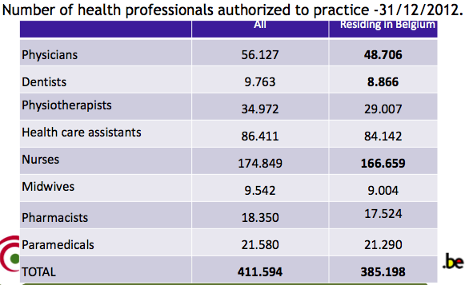
TANGIBLE CASES – BELGIUM (1)
Notes:
Belgium is exporting less than 5% of its HWF population. And some of those may be retired in sunny regions.

Slide 10
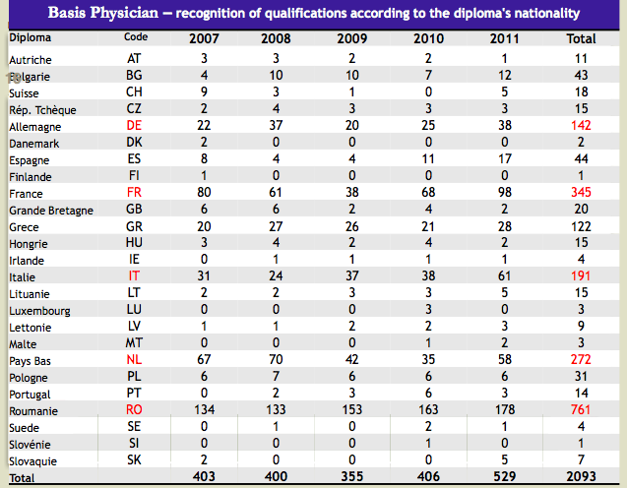
TANGIBLE CASES – BELGIUM (2)
Notes:
Neighbourhood effect
Close relation effect due to other type of previous migration & language compatibility (Italy & Romania)
Romania – before the entrance into EU there were connections and pathways to BE, now it is legal with some work protection improvement for the Romanian.

Slide 11
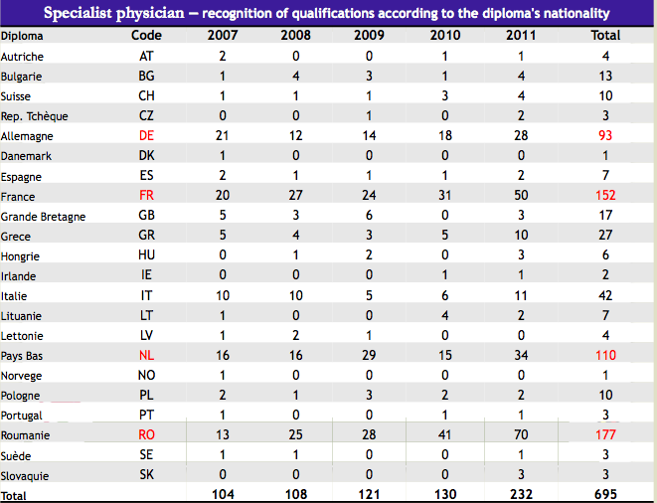
TANGIBLE CASES – BELGIUM (3)
Notes:
Raising trend !
Note that relation with FR & NL is also due to an escape route to their numerus clausus.

Slide 12
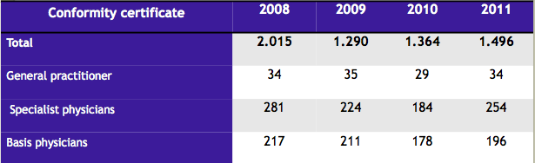
TANGIBLE CASES – BELGIUM (4)
Notes:
Willingness to leave ( not the same as effectively leaving) is stable.
Our pre-study established that « leaving » has a lot to do with the image the worker has of own country – BE keeps a high confidence level within own population (all types of work) and few countries show better.

Slide 13
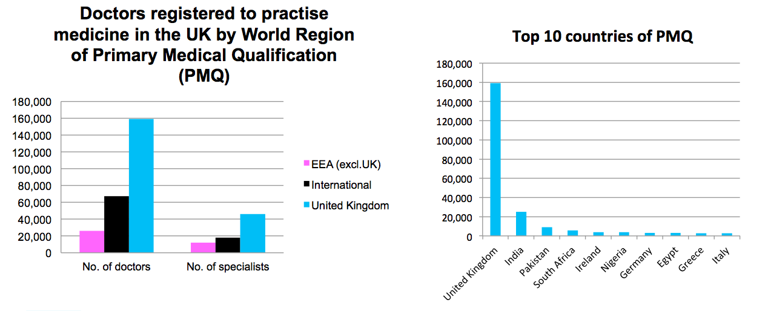
TANGIBLE CASES – UK (source GMC 2013)
Notes:
The situation of UK is different. There is an important dependence on foreign resources.
Foreign means Commonwealth – not EU.
The Gap show that UK also attracts as training place ! Universities induce mobility, that’s for sure.

Slide 14
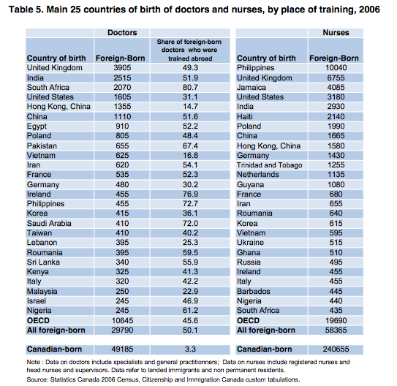
TANGIBLE CASES – CA - (source OECD 2008)
Notes:
Dependency is a key risk for some countries

Slide 15
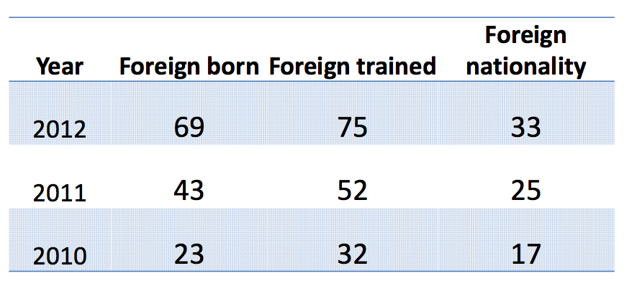
TANGIBLE CASES – HU (source MoH)
Discussion : outflow
Notes:
Is a growing trend once again.

Slide 16
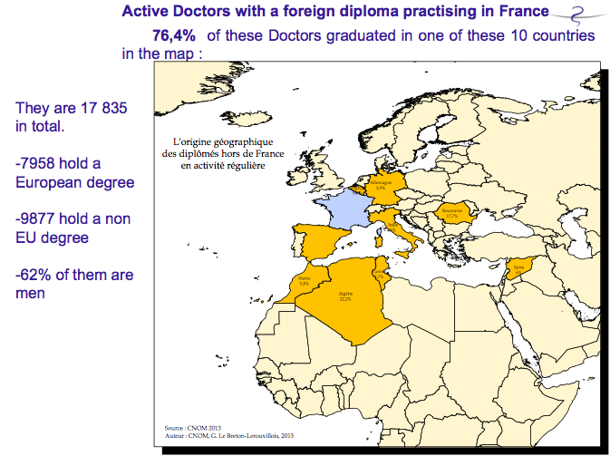
FRANCE & NORTHERN AFRICA
Notes:
France has same profile as Belgium:
Neighbour's first
Then special relations & language similarities

Slide 17

IN FACT WE KNOW A LOT ABOUT INFLOWS
Important studies to read :
Prometheus study (books I & II)
MohProf (Mobility of Health Professionals) study
RN4cast (this one on nurses)
But also :
Note / show a bit of this
Notes:
So as we know it all … why cannot we face the issues related ?

Slide 18
AND YET WE FEEL HELPLESS …
We have very poor data on outflow
We are not able to produce ECHIM indicator “mobility”
We have no qualitative date
“hit’ topic for parliamentary discussions
We do not have a EU data strategy
We do not know the price tag
We all know ecellent specialists who left
We all know good trainees who left
We have no grip on the outflow
Some countries face terrible consequences
In some countries, immigrants took a specific place in HC system
Others
Notes:
We all have stories related to mobility, good ones and bad ones.
In various countries, there is a huge part of parliamentary questions dedicated to HWF mobility, tainted with different of those stories depending on the political colour presenting the question.

Slide 19
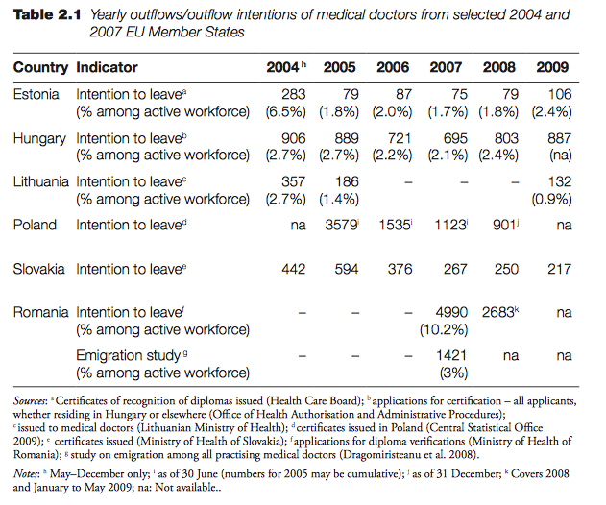
INTENTIONS
Notes:
In EU, we HAVE to recognize that some member states are facing a huge problem. Still, Poland showed that the situation can be reversed.

Slide 20
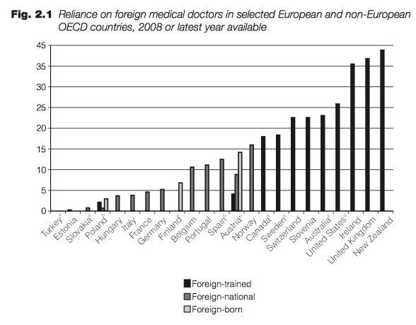
RELIANCE ON FOREIGN WORKFORCE

Slide 21
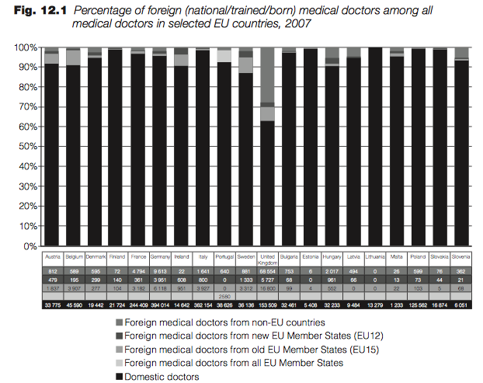
FOREIGN STUDENTS & SELF-SUFFIENCE

Slide 22
IS THERE A CHANGE DUE TO THE ECONOMICAL CRISIS ?
Yes & No, … there is an increased willingness to seek better living conditions & stability, but active recruitment is stopped.
The pressure on cost in the healthcare sector turned some official shortages into official plethora, cuts in salaries increases the drivers to move – but also reverses the movement between countries.
Limitation on the budget for healthcare is considered for setting targets within the planning process than calculated population needs, which often leads to a fear of plethora and limitation of home production, but could also create a “shock” helping the (fast) transformation of Health Systems. (see BG country example – Prometheus book II – p46)
Still … there are no Cost <-> benefits figures on the work of a doctor, making policy making on HWF an ideological debate.
Des-investment in HC systems together with lack of vision / incoherent response kills the faith in a country and creates exodus
Notes:
WE NEED VISION & more economical approach of HC.

Slide 23
OUTFLOW
Most drivers are NOT specific to health care workers
Better living conditions for the migrant and his family
Better training & carrier opportunities
Better infrastructures and greater hope for performing at high quality level
Better wages
Better work conditions
Language / Relations / Ethnicity / …
These are valid for 99% of the migrants.
The image of a country has a major effect and a depreciation leads to a snowball effect.
We have to recognize that during the long medical training, the conditions will changes. Some small size studies show that the creation of a local family & the social integration plays crucial roles for cancelling intentions to return home.

Slide 24
BACK TO : MOBILITY … VARIOUS CONCEPTS
… and variety of thoughts
Permanent mobility to EU
  Most of the time from EAST to WEST
  Or through language / former colonies attraction
  (Commonwealth / Africa / Latin America / …)
  But also from USA / Canada / Countries at war / …
  EU immigration strategy
  Application of national law
  Application of previous bilateral agreement
  Negotiation on bilateral agreements
Country of entrance is not to be considered a country of final destination
Applicability of the WHO Global Code for ethical recruitment of HWF

Slide 25
BACK TO : MOBILITY … VARIOUS CONCEPTS
… and variety of thoughts
Permanent mobility intra EU
  To another country than nationality / training country
    Similar factors as non-EU
    Special influence of education
      Structural education proposals e.g. In Norway, a fund encourage 40% of students in medicine to receive an foreign education
      Escape route to numerus clausus and shortage of education possibilities
      Renowned universities as magnet
  Potential of Circular mobility

Slide 26
BACK TO : MOBILITY … VARIOUS CONCEPTS
… and variety of thoughts
Permanent mobility from EU
Importance of the “through” flow:
  U.K. both attracts medical doctors, and looses medical doctors for US, Canada & Australia
  Germany attracts from central and eastern Europe, and German doctors are attracted to go west.
Some U.K. responsible consider unbalances in the US (development of a broader insurance coverage system) to be a real threat to U.K. health workforce.
Case Ireland – most immigrants took junior positions and are limited after a few years in career opportunities (also due to budget reductions) and would migrated again
…

Slide 27
BACK TO : MOBILITY … VARIOUS CONCEPTS
… and variety of thoughts
The needs from outside of EU
Currently Africa / Latin America / Eastern Europe / SE Asia are often considered as “plundered” by High Income Countries… but the real issue is that we need more than 6.000.000 HC Workers
Country response : Brazil
Note / See presentation Mais Medicos on http://www.euhwforce.eu/web_documents/JAHWF-CONFERENCE-1-BRATISLAVA/DOCUMENTS/140129_BOSESSION3_BRAZIL.pdf

Slide 28
PLANNING ?
ABONDANCE OF DATA ⬄ TERRIBLE LACK OF FIGURES
From 7 to 10 countries in Europe not only collect data on health professionals, but also tend to forecast with a supply and demand based model, leading to potential planning actions on the political level.
Mobility is an increasing threat for planning because of its growing importance, and unpredictability. Currently, due to lack of data those ‘planning’ countries are struggling, … the other one are helpless.
When identifying importance of shortages, mobility can provide an answers, but self sustainability is the official message
Though, long term vision recommend self-sustainability at country (or regional) level.

Slide 29
WHAT ARE WE DOING ABOUT IT ?
Ref. Chapter 12 of Prometheus : The unfinished workforce agenda

Slide 30
THE LEGAL INSTRUMENTS
Mutual recognition (2005/36/EC and soon 2013/55/EU)
Is a tool to support mobility of regulated and unregulated professionals
Provide processes to support quality and takes into account to a certain extend the specificity of health care professions
Strictly restrict the applicability of compensation measures to relevant gaps in the competence
Opens the door for uncertified training and professional experience to motivate an appliance to recognition
Builds in a system of ex-ante control and foresee the exchange of information between Member States
Still this important tool is the results of a compromise. The discrepancies of the curricula, health care systems (but also habits) & number of specialities remains a major threat for quality of the process
Applies only for the persons that respond to the definition of “(EU) migrant”, not the most non-EU citizen, non-EU trained persons

Slide 31
THE LEGAL INSTRUMENTS
EU Blue Card scheme (Directive 2009/50/EC)
helps attract highly qualified migrants to Europe, supporting Member States' and EU companies' efforts to fill gaps in their labor markets that cannot be filled by their own nationals, other EU nationals or legally resident non-EU nationals
Belgian case
BE specific system for applying when the 2005/36/EC is not applicable
=> criticism / difference in treatment
But also specific system for temporary allowance to practice, to support training for countries that need specific competence
  => Criticism / room for inappropriate usage - creates expectations
  EU Blue Card is not really used.

Slide 32
EU HWF PLAN
EU The action plan for the EU health workforce seeks to help EU countries work together to tackle these challenges and boost employment by:
  improving health workforce planning and forecasting
  anticipating future skills needs
  improving recruitment and retention of health professionals
  mitigating the negative effects of migration on health systems.

Slide 33
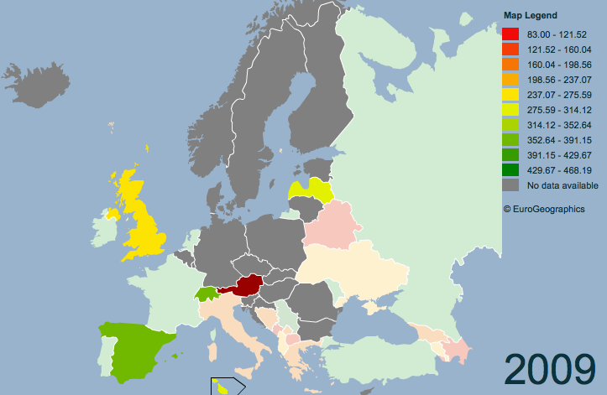
DATA COLLECTION & PLANNING 1
Monitor the trends
European Community Health Indicators (ECHI) is project that was carried out under the Health Monitoring Programme and the Community Public Health Programme 2003-2008. The aim was to advance health monitoring throughout Europe by developing relevant and comparable health indicators and by making them available in the EU and its Member States (MSs). A list of 88 'indicators' (ECHI short list) was developed.
Indicator 63. “Physicians employed” is available (e.g. http://www.statistik.at/web_en/statistics/health/european_community_health_indicators_echi/index.html - page 7 and http://ec.europa.eu/health/indicators/echi/list/index_en.htm )
Indicator 65. “Mobility of professionals” is not available yet.

Slide 34
DATA COLLECTION & PLANNING 2
International data collection and comparability
WHO / OECD / EUROSTAT have agreed on a Joined Questionnaire
Discrepancies of the definitions is the major identified issue;
Discrepancies on the accuracy of data delivery (time & quality) is the second major issue
WHO / OECD / EUROSTAT have projects to upgrade the process (improvement – no revolution)
MEMBER STATES representatives are concerned about
The analysis made by these international bodies on incomparable data
The analysis made by the government on the resulting statements
There is room for improvement locally & globally

Slide 35

ETHICAL - CODE
The European Social Dialogue in the hospital and healthcare sector has agreed a Code of Conduct on the Ethical Cross-Border Recruitment and Retention in the Hospital Sector and a Framework of Actions on Recruitment and Retention.
Strategy for Action on the Crisis in Human Resources for Health in Developing Countries (European Commission, 2005b), and in 2006, the Programme for Action to Tackle the Shortage of Health Workers in Developing Countries (2007–2013) (European Commission, 2006)
The WHO Global Code of Practice on the International Recruitment of Health Personnel has been countersigned by adopted by the 193 Member States of the World Health Organization.
Note / See presentation from Dr. Perfilieva
Project Health Workers for All
“We believe everyone should have access to health workers”
http://www.healthworkers4all.eu

Slide 36
The JA EUWHF
General Objective
To collaborate and exchange between Member States to support them in their health workforce planning and to increase Member States’ and Europe’s capacity to take effective and sustainable measures.
Focus on 5 professions :
  doctors
  nurses
  pharmacists
  dentists
  midwives
Starting date:
April 1st 2013
Duration:
3 years

Slide 37
The JA EUHWF: specific objectives
Increased Knowledge
Improved tools
Higher effectiveness
Increased knowledge :
Better understanding of terminology
Updated information on mobility trends
Estimation of future skills and competencies needed for the HWF
Improved tools:
Guidelines on quantitative and qualitative planning methodologies
Platform for cooperation to find possible solutions on expected shortages
Higher effectiveness:
Better monitoring by access to timely data
Increased quantitative and qualitative planning capacity
Higher impact of HWF planning and forecasts on policy decision making

Slide 38
The JA EUHWF : Core work packages
WP 4
HWF planning data
Hungary
WP 5
Quantitative methodology
Italy
WP 6
Horizon scanning
UK
WP 7
Sustainability
Bulgaria
& Belgium
Terminology mapping
Mobility data
WHO Code
HWF planning data
Minimal data set
Quantitative planning methodology
Pilot project
Estimation of future needs
Qualitative planning methodology
Pilot project
Network of experts
Policy advice
Technical recommen-dations

Slide 39
The JA EUHWF : Tangible outcome
EU and Member State level
Focus on both technical implementation & Policy making
Feasible
Reports and recommen-dations
Guidelines and toolkits
Pilot projects
Web portal + Network of experts
HWF Planning guide
Enabling Competent authorities to progress in planning HWF
Enabling to look further then the current horizon
Improving dialogue with unified definitions
Start Data collection & Planning : IT & PT
Already new demands: snowball effect
Horizon scanning: BE on General Practitioners

Slide 40
STUDENTS SURVEY (in partnership with EMSA)
Currently, we are conducting the pilot phase of a survey among the future generations of Health Care Workers. Within this one, an important question for the “sending” countries is to be answered :
Do these students already think of leaving the country ?
For Med. Sdts – their opinion on training & career opportunities
TODAY (pilot study only) :
BE nurses & midwifes / 0% now thinks to leave
CZ & SK pharmacists / around 15% think of leaving – 4% will actively try to
BG doctors & pharmacist / a majority think of leaving
BUILDING AN EU NETWORK OF EXPERTS
To support EU policy making and even more to advise Member States.
Experts in planning, HC systems, policy making, labour &, Education
Notes:
We believe it we haven’t talked to the students enough in the past while it is for them also that we plan HWF.

Slide 41
BILATERAL AGREEMENTS
Bilateral agreements are considered as promising tools for helping states to manage migrations.
Positive descriptions on training agreements – improving students qualification and fullfilling their expectations – controlled introduction to a world of mobility
Covering structural shortages
Common labour market
Agreement on potential compensation for emmigration
Creating communication mechanism
A pilot survey made by EU DG SANCO concludes that even though the instrument is growing, there is no homogeneity and few bilateral relations are covered.
MOLDOVA is an initiator on this topic.
Other example : Triple Win approach – see presentation on http://www.euhwforce.eu/web_documents/JAHWF-CONFERENCE-1-BRATISLAVA/DOCUMENTS/140129_BOSESSION3_3WIN.pdf

Slide 42
RETENTION STRATEGIES
Use lessons learned
Take local responsibilities on work conditions and country image
But even more :
- Work differently !
PROMOTION OF ETHICAL RECRUITMENT
Build awareness of the WHO CODE
Assess applicability to EU
Measurable implementation

Slide 43
VARIETY OF SYSTEMS – VARIETY OF LESSONS
The current focus is on skill mix (mostly seen as task/responsibility transfer)
Though, sharing experience leads to innovative solution and transposition under pressure of the crisis / the shortages / the technical evolutions
Planning is most of the time either inexistent, or short term (12 years in advance)
HORIZON SCANNING IS A MUST TO IDENTIFY WHAT WILL CHANGE FORTHE MEDICAL PROFESSIONS
(medical issues, but also patient empowerment, IT evolution, other way of practicing, new organisation of medicine, …)
Important implication on the skills (CURRICULA & CPD) we need now and tomorrow
Important implication on the redistribution of health professionals

Slide 44
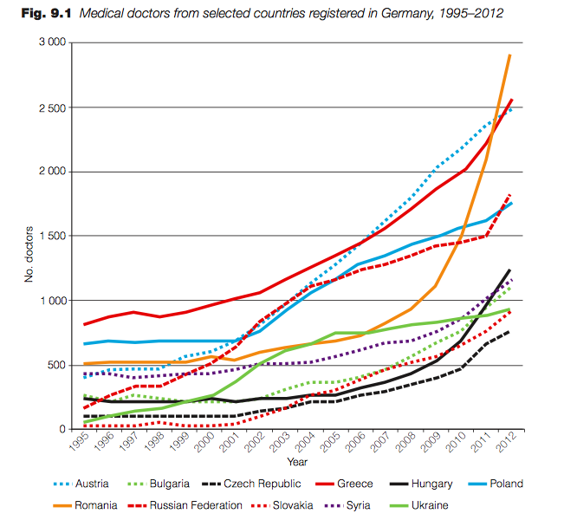
CONCLUSIONS
Mobility is a benefit, … but is no (longer?) seen as such by most states
Shortages and pressure on costs and quality starts inducing a war for talent of today
Mobility is growing much faster than the current
response of our States
In 40 years of career, a lot can and will change
also the career content and the approach of mobility
High complexity, available data, lack of analysis, need for global and local initiatives
Are the values of our society high on the agenda ?

Slide 45
CONCLUSIONS
MESSAGES TO YOUR NETWORK
Your role of making students “ready for the world”, but still showing the value of own country is even higher during initial training
Communication with the students and early identification of their expectations is important
Breaking fears, add human values, help political level, bring your messages – isn’t this a role Universities have always done ?
Courageous policies, not only from the Government but even more from the medical world are needed

